Slide 1
Sales Forecasting for Furniture Store
By Sandesh Pednekar
18/04/2024

Slide 2
Problem Statement
For a retail furniture store, predicting future sales is critical to avoiding inventory issues like overstocking or under-stocking.
The challenge lies in utilizing time series data from the superstore dataset to forecast furniture sales for the next year accurately.
Predictive insights ensure an optimal customer experience, avoid losses, and maintain store sustainability.

Slide 3
Overview of Dataset
Dataset Name: Superstore Dataset
Contents:
Contains historical data of a furniture store
Includes information on sales, profit, quantity, discount, and more
Objective: Utilize the dataset for sales forecasting of the furniture store
Key Features:
Time series data with timestamps
Various attributes such as Ship Mode, Region, and Sub-Category

Slide 4
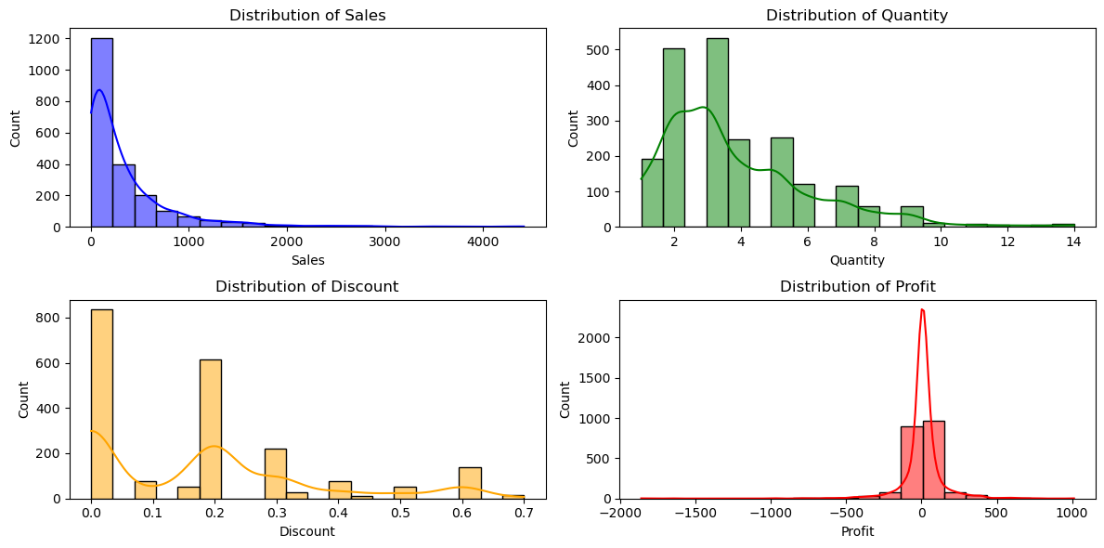

Slide 5
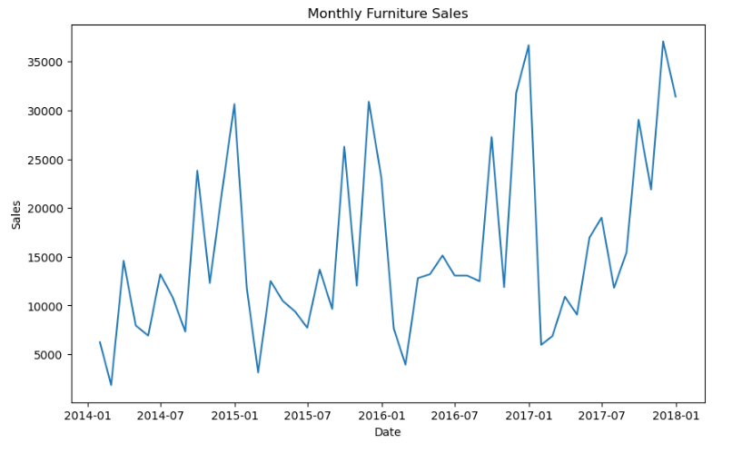

Slide 6
Components of Time Series from dataset
Trends:
~Long-term increase or decrease in data over time
~Helps identify overall direction of the data
Seasonality:
~Repeating patterns or cycles at fixed intervals
~Can be daily, weekly, monthly, etc.
Residuals:
~Differences between observed values and predicted values
~Useful for assessing the goodness of fit of a model

Slide 7
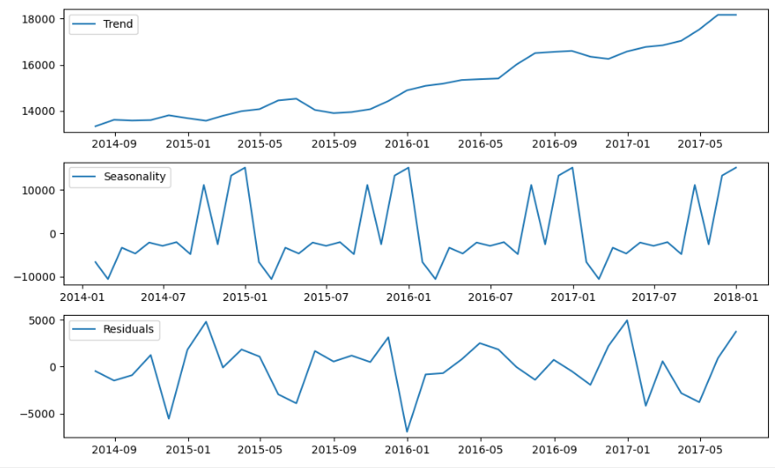

Slide 8
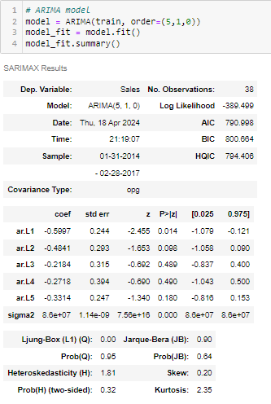
Forecasting Techniques

Slide 9
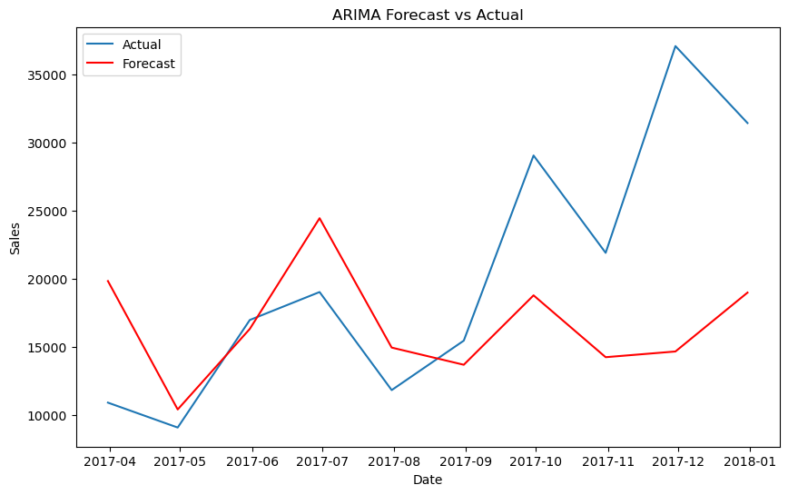

Slide 10
Learning Outcome
Evaluation metrics:
Mean Absolute Error (MAE): 7397.620
Mean Squared Error (MSE): 94485058.362
Root Mean Squared Error (RMSE): 9720.343

Slide 11
Summary and Conclusion
Main Objectives:
The main objective of this project was to forecast sales for a furniture store using time series analysis techniques.
We aimed to leverage historical sales data to predict future sales accurately, allowing the store to optimize inventory management and improve business operations.
Key Findings:
Through exploratory data analysis, we identified trends and seasonality patterns in the sales data.
Time series decomposition revealed underlying components such as trend, seasonality, and residuals.
We applied various forecasting models, including ARIMA, to predict future sales based on historical patterns.
The evaluation metrics, including Mean Absolute Error (MAE), Mean Squared Error (MSE), and Root Mean Squared Error (RMSE), provided insights into the accuracy of our forecasts.
Importance of Sales Forecasting:
Sales forecasting plays a crucial role in business sustainability by enabling proactive decision-making and effective resource allocation.
By accurately predicting future sales, businesses can optimize inventory levels, streamline supply chain operations, and enhance customer satisfaction.
Effective sales forecasting also helps businesses identify emerging trends, anticipate market demand, and stay competitive in dynamic market environments.

Slide 12
Thank you…!!

